Slide 1
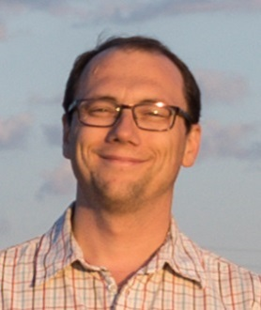
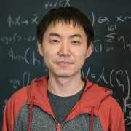
Chasing the Long Tail:
What Neural Networks Memorize and Why
_{Vitaly Feldman}
_{Apple*}
_{Chiyuan Zhang}
_{Google Research}
*Part of the work done while at Google Research
and while visiting the Simons Institute, UC Berkeley

Slide 2
Label memorization
For state-of-the-art deep learning algorithms on text/image datasets
Training set error: 0-5%
(Typical) test set error: 10-30%
Inception on ImageNet 1000 with random labels:
Training error: 9%
Test error: 99.9%
[Zhang,Bengio,Hardt,Recht,Vinyals ‘17]
Not explained by existing theories

Slide 3
Defining memorization
Def: For dataset $S=(\left(x_{1},y_{1}\right),…,(x_{n},y_{n}))$, $i∈[n]$ and learning algorithm $A$ let
$$mem\left(A,S,i\right)=\underset{\hat{h}=A\left(S\right)}{Pr}\left[\hat{h}\left(x_{i}\right)=y_{i}\right]−\underset{\hat{h}=A\left(S\backslash i\right)}{Pr}\left[\hat{h}\left(x_{i}\right)=y_{i}\right]$$
For data distribution$P$ over $X×Y$
$$\underset{ S∼P^{n}}{E}\left[\frac{1}{n}\sum_{i∈[n]}{mem\left(A,S,i\right)}\right] ≈\underset{ S∼P^{n},\hat{h}=A\left(S\right)}{E}\left[err_{P}\left(\hat{h}\right)−err_{S}\left(\hat{h}\right)\right]$$
generalization
error
empirical
error
generalization gap
Why is label memorization ubiquitous?

Slide 4
Privacy concerns
Black-box membership inference attack with high accuracy
[Shokri,Stronati,Song,Shmatikov 17; LongBWBWTGC 18; SalemZFHB 18,…]
Is memorization necessary for achieving optimal error?
Notes:
Concrete question

Slide 5
What about theory?
Generalization error of $\hat{h}=A(S)$:
${err}_{P}\left(\hat{h}\right)={\hat{err}}_{S}\left(\hat{h}\right)+\left({err}_{P}\left(\hat{h}\right)−{\hat{err}}_{S}\left(\hat{h}\right)\right)$
empirical
error
generalization gap
Controlled via a proxy
VC-dim, margin, norms
stability etc.
For example, for a class of binary classifiers $F$
$${err}_{P}\left(\hat{h}\right)−{\hat{err}}_{S}\left(\hat{h}\right)≤2⋅Rad\left(F,S\right)+c\sqrt{\frac{ln\left(1/δ\right)}{n}}$$
Ideal algorithm: $\hat{h}={argmin}_{h∈F}\left\{{\hat{err}}_{S}\left(h\right)+proxy\left(h,S\right)\right\}$

Slide 6
Related work
Generalization of interpolating methods
Interpolation may be “harmless”
Does not address the “why?” question
Memorization also happens without interpolation
Overparametrization is useful
Easier to optimize and richer space of models
Does not imply interpolation/memorization
[Cover,Hart ’67; Belkin,Hsu,Mitra ‘18;
Liang,Rakhlin ’18; Belkin,Rakhlin,Tsybakov ’19;
Belkin,Hsu,Xu ’19; Bartlett,Long,Lugosi,Tsigler ‘19;
Hastie,Montanari,Rosset,Tibshirani ’19;
Muthukumar,Vodrahalli,Sahai ’19; Mei,Montanari 19;
Montanari,Zhong 20; ….]

Slide 7
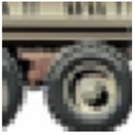
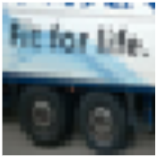
Hard atypical examples
CIFAR-10 truck class
training set
test set
Notes:
Note: order

Slide 8
Subpopulations
CIFAR-10 birds
Examples from low $\left(≈\frac{1}{n}\right)$ frequency subpopulations may be hard
to distinguish from mislabeled ones and outliers

Slide 9
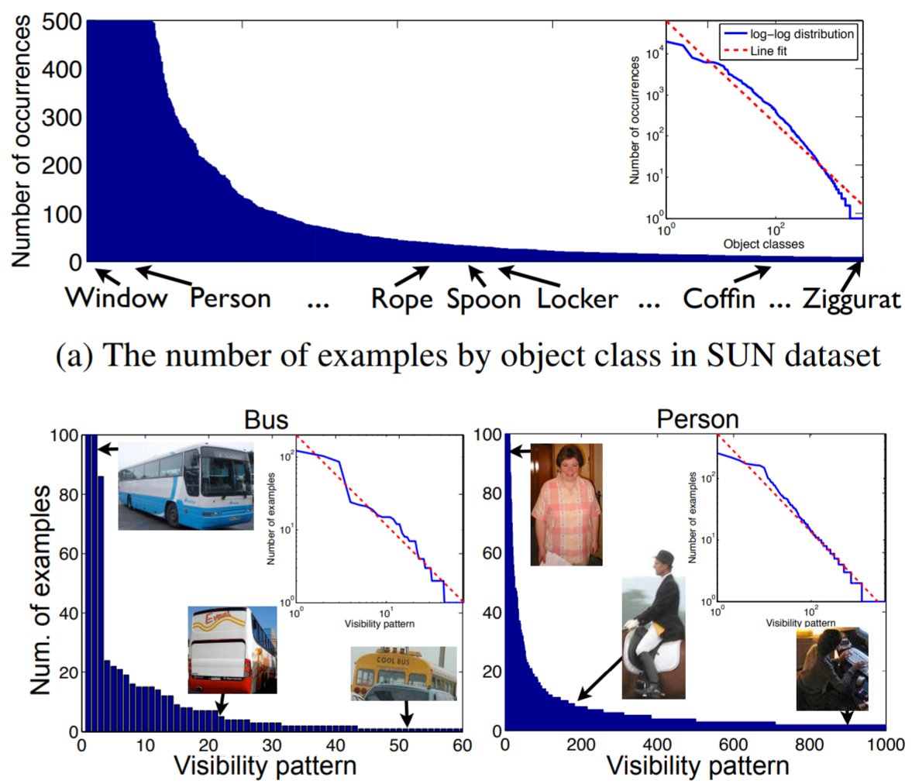
Long-tailed data
Additional annotations
[Zhu, Anguelov, Ramanan ’14]

Slide 10
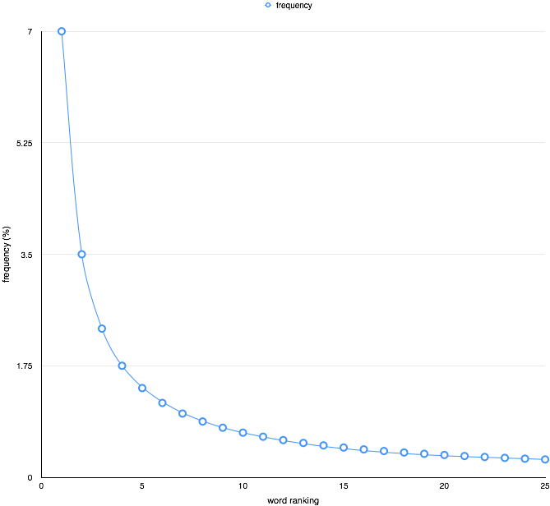
The tail rears its head
For $n≤s$
$$\underset{}{{weight}_{π_{s}}}\left[\frac{1}{2n},\frac{2}{n}\right]=Ω\left(\frac{1}{\log{s}}\right)$$
Zipf distribution
$$Pr\text{[}α=k\text{]}∝1/k$$
Long-tail: $Θ\left(\frac{1}{n}\right)$ frequencies can make up a significant fraction
of the whole population

Slide 11
Basic model
Discrete domain $X$ of size $s$ and set of labels $Y$
Learning problem: meta-distribution $Φ$ over data distributions on $X×Y$
Goal: minimize expected generalization error of algorithm $A$
${\overline{err}}_{n}\left(Φ,A\right)≔\underset{P∼Φ, S∼P^{n}, \hat{h}=A\left(S\right)}{E}\left[{err}_{P}\left(\hat{h}\right)\right]$
Prior over frequencies $π=\left(π_{1},…,π_{s}\right)$
For each $x∈X$, pick randomly and independently a frequency $p_{x}$ from and normalize
$$D\left(x\right)=\frac{p_{x}}{\sum_{x^{′}∈X}{p_{x^{′}}}}$$
Arbitrary distribution $F$ over functions $X→Y$
$Φ(π,F)$: pick $D∼π^{s}$ and $f∼F$. Define $P$as $(x,f\left(x\right))$ for $x∼D$

Slide 12
Benefits of fitting
Thm: For every algorithm $A$:
$$\underset{P∼Φ(π, F), S∼P^{n}, \hat{h}=A\left(S\right)}{E}\left[{err}_{P}\left(\hat{h}\right)\right]≥{opt}_{n}\left(π,F\right)+τ⋅\underset{P∼Φ(π, F), S∼P^{n}, \hat{h}=A\left(S\right)}{E}\left[{errn}_{S}\left(\hat{h},1\right)\right]$$
$$τ≔ \frac{\underset{α∼π}{E}\left[α^{2}{\left(1−α\right)}^{n−1}\right]}{\underset{α∼π}{E}\left[α{\left(1−α\right)}^{n−1}\right]}$$
$$\min_{A} {\overline{err}}_{n}\left(Φ(π,F),A\right)$$
Number of examples occurring once in $S$ but not fit by $\hat{h}$
For all $π$,$n$, $τ=Ω\left(\frac{{weight}_{π}\left[\frac{1}{2n},\frac{2}{n}\right]}{n}\right)$
For Zipf and $n≤s,$ $τ=Ω\left(\frac{1}{n\log{s}}\right)$
$F$ can be arbitrarily complex
Extends to label noise

Slide 13
Fitting and memorization
Def: For dataset $S=(\left(x_{1},y_{1}\right),…,(x_{n},y_{n}))$, $i∈[n]$ and learning algorithm $A$ let
$$mem\left(A,S,i\right)=\underset{\hat{h}=A\left(S\right)}{Pr}\left[\hat{h}\left(x_{i}\right)=y_{i}\right]−\underset{\hat{h}=A\left(S\backslash i\right)}{Pr}\left[\hat{h}\left(x_{i}\right)=y_{i}\right]$$
For sufficiently complex $F$: for many $i∈[n]$
$$\underset{\hat{h}=A\left(S\backslash i\right)}{Pr}\left[\hat{h}\left(x_{i}\right)=y_{i}\right]≪1$$
Thus need to be memorized to fit

Slide 14
Beyond discrete domains
Domain $X$
Distributions $M_{1},…,M_{s}$ with disjoint supports $X_{1},…,X_{s}$
Prior over frequencies $π=(π_{1},…,π_{s})$
For each $i∈[s]$, pick randomly and independently frequency $p_{i}$ according to $π$ and normalize $α_{i}=\frac{p_{i}}{\sum_{j∈\left[N\right]}{p_{j}}}$
Define $D\left(x\right)=\sum_{i∈[s]}{α_{i}M_{i}(x)}$
$F$ is a distribution over functions $X→Y$ constant over every $X_{i}$
$Φ(π,F)$: pick $D$ as above and $f∼F$. Define $P$as $(x,f\left(x\right))$ for $x∼D$

Slide 15
Coupling
Def: Algorithm $A$ is $λ$-subpopulation-coupled if for every $S$ and $(x,y)∈S$ which is the only representative from $M_{k}$ in $S$
$$TV\left(\hat{h}\left(x\right),\hat{h}\left(x^{′}\right)\right)≤1−λ$$
where $\hat{h}=A(S)$ and $x^{′}∼M_{k}$
Thm: For every $λ$-subpopulation-coupled $A$
$$\underset{P∼Φ(π, F), S∼P^{n}, \hat{h}=A\left(S\right)}{E}\left[{err}_{P}\left(\hat{h}\right)\right]≥{opt}_{n}\left(π,F\right)+λ⋅τ⋅\underset{P∼Φ(π, F), S∼P^{n}, \hat{h}=A\left(S\right)}{E}\left[{errn}_{S}\left(\hat{h},1\right)\right]$$
Examples:
$k$-Nearest Neighbor
Large-margin linear classifiers/SVM in over-parameterized regime

Slide 16
Empirical validation
Def: For dataset $S=(\left(x_{1},y_{1}\right),…,(x_{n},y_{n}))$, $i∈[n]$ and learning algorithm $A$ let
$$mem\left(A,S,i\right)=\underset{\hat{h}=A\left(S\right)}{Pr}\left[\hat{h}\left(x_{i}\right)=y_{i}\right]−\underset{\hat{h}=A\left(S\backslash i\right)}{Pr}\left[\hat{h}\left(x_{i}\right)=y_{i}\right]$$
Requires training $Ω(n)$ models. Computationally infeasible!
Def: For $m≤n,$ let $T$ be a random subset of $S$ of size $m$ that includes $i$
$${mem}_{m}\left(A,S,i\right)=\underset{T}{E}\left[\underset{\hat{h}=A\left(T\right)}{Pr}\left[\hat{h}\left(x_{i}\right)=y_{i}\right]−\underset{\hat{h}=A\left(T\backslash i\right)}{Pr}\left[\hat{h}\left(x_{i}\right)=y_{i}\right]\right]$$
Closely-related and requires training $O(1)$ models! Use $m=0.7n$

Slide 17
Method
Estimate memorization values ${mem}_{m}\left(A,S,i\right)$:
Generate $S_{1},…,S_{r}$ random subsets of $S_{train}$ of size $m$
Train models ${\hat{h}}_{i}$ on $S_{i}$
For each example $\left(x_{i},y_{i}\right)∈S_{train}$
${\tilde{mem}}_{m}\left(A,S,i\right)=\underset{k∼[r]}{Pr}\left[{\hat{h}}_{k}\left(x_{i}=y_{i}\right) | x_{i}∈S_{k}\right]−\underset{k∼[r]}{Pr}\left[{\hat{h}}_{k}\left(x_{i}=y_{i}\right) | x_{i} ∉S_{k}\right]$
Still computationally intensive: requires large $r$ (>1,000)

Slide 18
Examples of memorization estimates
High memorization estimate
ImageNet: bobsled class
Low memorization estimate

Slide 19
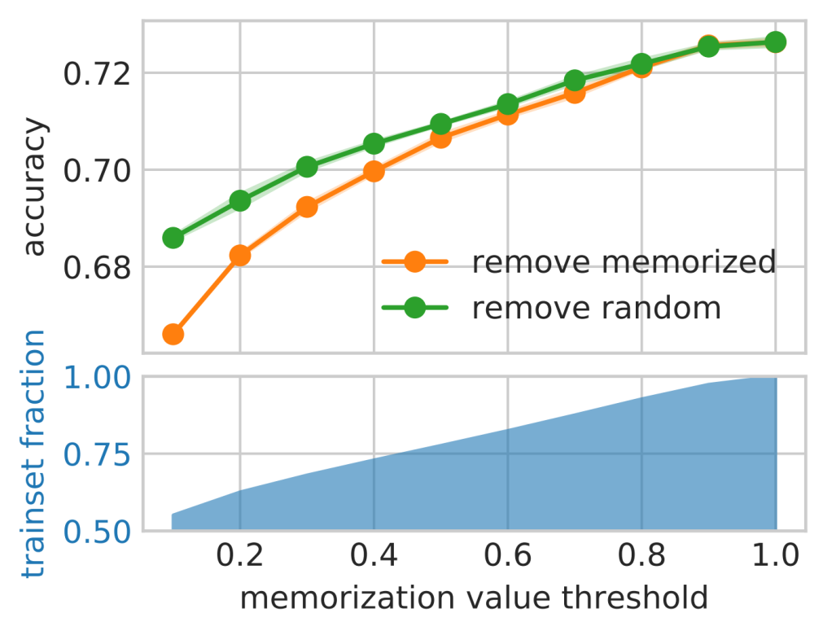
Benefits of memorization for ImageNet

Slide 20
Influence of memorized examples
Def: For dataset $S=(\left(x_{1},y_{1}\right),…,(x_{n},y_{n}))$, $i∈[n]$ and testing example $(x,y)$
$$infl\left(A,S,i,(x,y)\right)=\underset{\hat{h}=A\left(S\right)}{Pr}\left[\hat{h}\left(x\right)=y\right]−\underset{\hat{h}=A\left(S\backslash i\right)}{Pr}\left[\hat{h}\left(x\right)=y\right]$$
Same trick!
Def: For $m≤n,$ let $T$ be a random subset of $S$ of size $m$ that includes $i$
$${infl}_{m}\left(A,S,i,(x,y)\right)=\underset{T}{E}\left[\underset{\hat{h}=A\left(T\right)}{Pr}\left[\hat{h}\left(x\right)=y\right]−\underset{\hat{h}=A\left(T\backslash i\right)}{Pr}\left[\hat{h}\left(x\right)=y\right]\right]$$

Slide 21
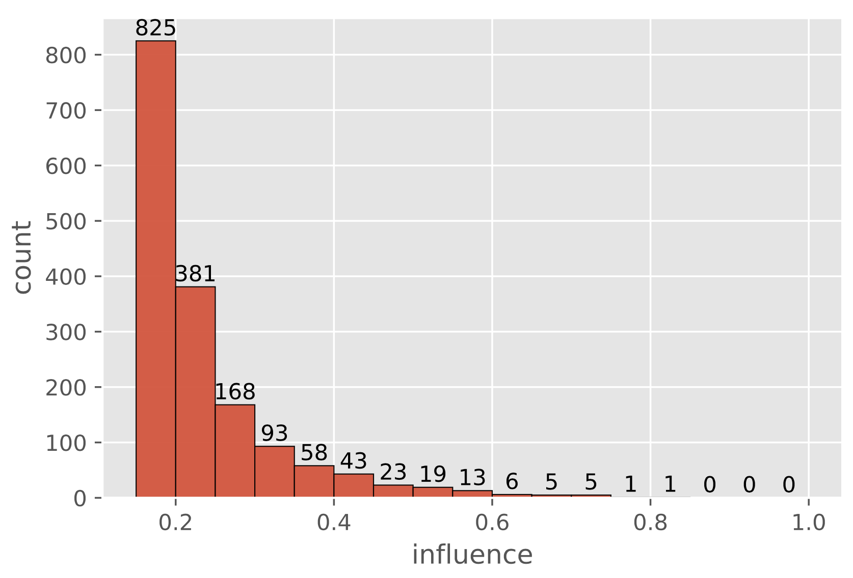
High-influence pairs
Many memorized training examples each of which significantly influences the accuracy on just one test example
Affects $≈3\%$ of the ImageNet test set

Slide 22
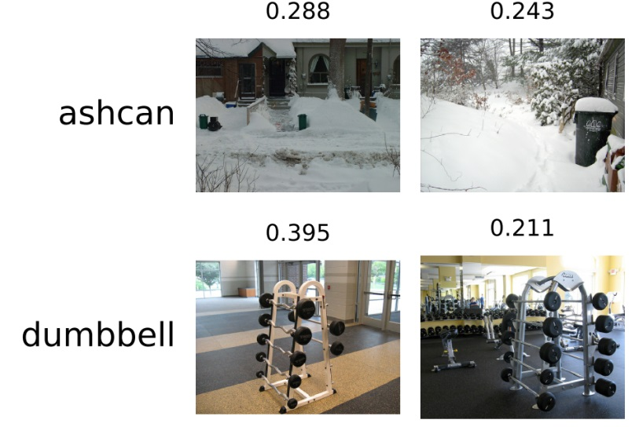
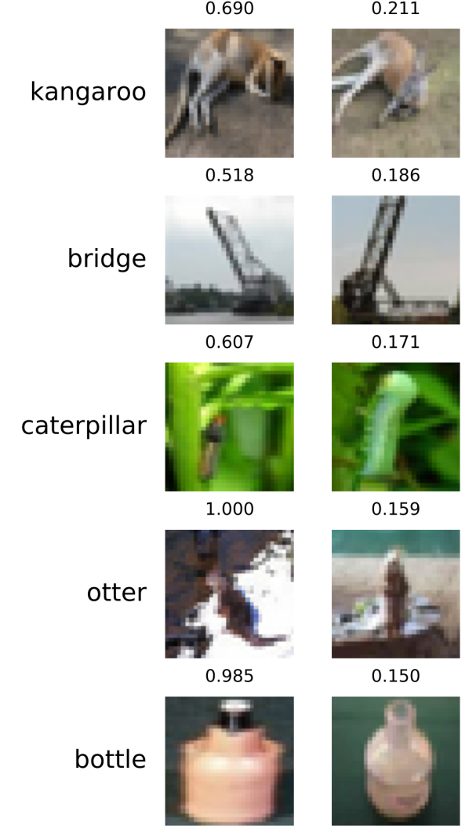
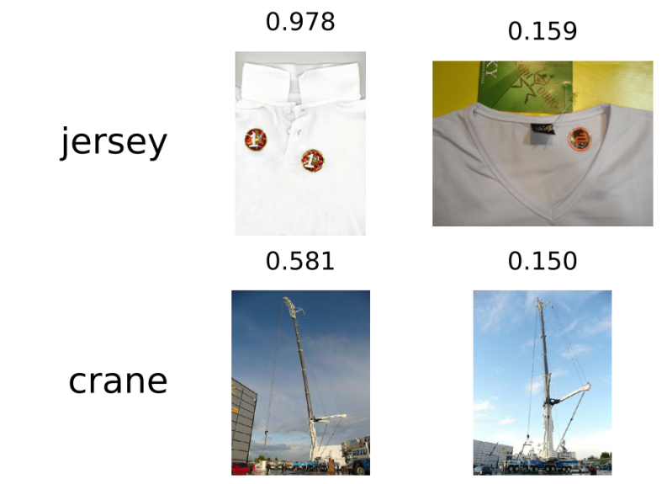
Examples of high-influence
train
test
train
test
ImageNet
CIFAR-100

Slide 23
Conclusions
Label memorization is necessary for optimal generalization on long-tailed data distributions
Not algorithm-specific
Can be modelled theoretically
Additional materials
Theory: STOC 2020, https://arxiv.org/abs/1906.05271
Experiments: NeurIPS 2020, https://arxiv.org/abs/2008.03703
Results/additional examples: https://pluskid.github.io/influence-memorization/
Follow-up: memorization of data points
with Gavin Brown, Mark Bun, Adam Smith and Kunal Talwar
STOC 2021: https://arxiv.org/abs/2012.06421
Future work
Faithful models of learning
Implications of limiting memorization: effect on the accuracy depends on subgroup frequency
Applications of estimators

